Slide 1



ling
yang
ben
xue
xi
零 样 本 学 习
数据科学基础课程课堂汇报
Principles of Data Science
汇报人
陈垍铮

Slide 2
壹
贰
叁
肆
目
研究背景略谈
研究方法介绍
研究结果分析
研究未来展望
录

Slide 3
yi
壹
PART ONE
研究背景略谈
The background and significance of the work

Slide 4
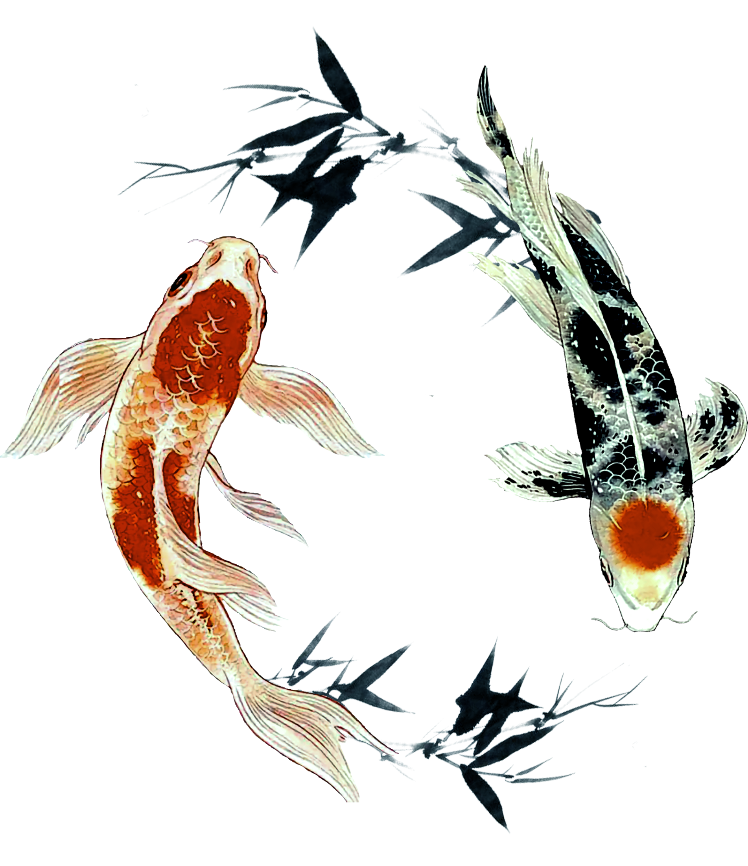

研究背景略谈
Reproduce Reasearch Results
Verify the correctness of the implementation by making my own implementation results on the same order of magnitude as the baseline model results of each paper
Model Performance comparison
研究背景
Compare the performance differences of the three types of models and analyze the causes
Model Performance comparison
Model selection is carried out through parameter adjustment and model structure refinement

Slide 5
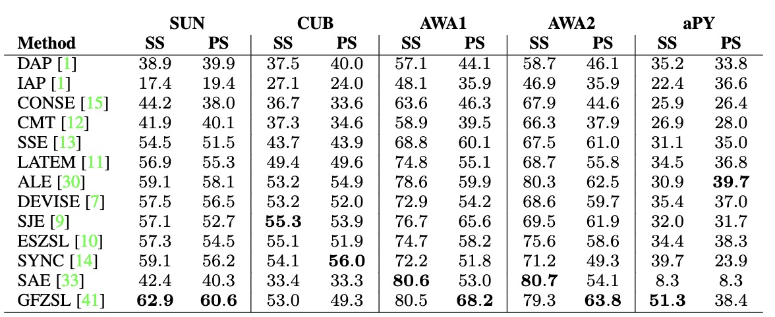

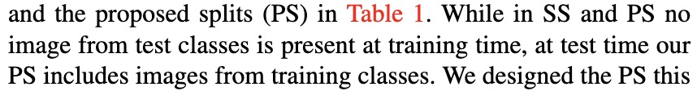
模型结果复现之细节
Zero shot learning and
few shot testing set
Yongqin Xian, et al. "Zero-Shot Learning - A Comprehensive
Evaluation of the Good, the Bad and the Ugly." arXiv, 2020.

Slide 6
er
贰
PART TWO
研究方法介绍
The methods and details of the work

Slide 7




研究方法介绍
Sematic Relatedness
Semantic Embedding
Vary model scales
Vary sim-mat generation
Vary model scales
Vary prediction paradigm
Synthetic method
Experiment Settings
Different learning rates
Different fake sample number
Raw data generation

Slide 8
Sematic Relatedness
Implementation Details
Apply various attributes
num_class
1. Train our classifier on training dataset.
2.Constructing similarity matrix based on class attributes.
3.Multiply the [bz,num_class] prediction result with the [num_class,num_class] matrix to get test prediction results.
4.Select the maximum dimension on testing classes.
bs
Prediction results
Normalize on each sample
similarity matrix

Slide 9
研究方法介绍
Sematic Relatedness
Semantic Embedding
Vary model scales
Vary sim-mat generation
Vary model scales
Vary prediction paradigm
Synthetic method
Experiment Settings
Different learning rates
Different fake sample number
Raw data generation

Slide 10
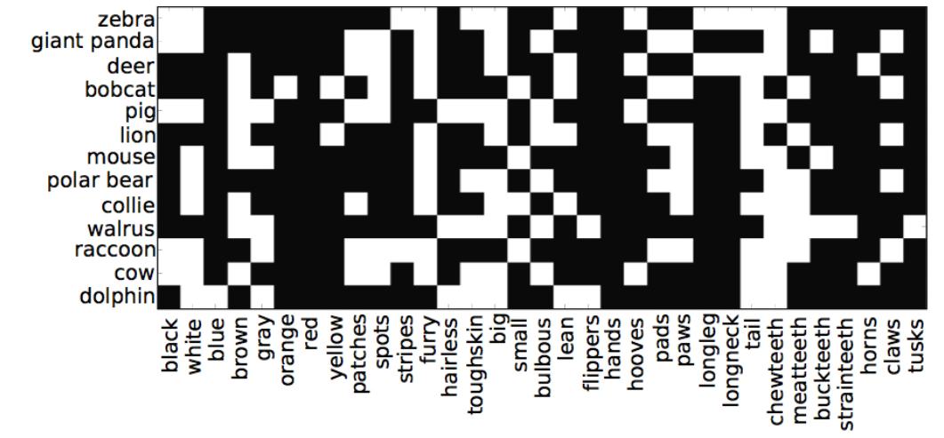
Sematic Embedding
Implementation Details
1. Train our classifier on training dataset, here instead of predicting true label of each sample, we predict the attribute vector of a sample.
2. During testing time, output a [bs, att_dim] matrix, use the label of the most similar class as the predicted class.
3.Select the maximum dimension on testing classes.
Big model: ensure ability
Small model: avoid overfit

Slide 11
研究方法介绍
Sematic Relatedness
Semantic Embedding
Vary model scales
Vary sim-mat generation
Vary model scales
Vary prediction paradigm
Synthetic method
Experiment Settings
Different learning rates
Different fake sample number
Raw data generation

Slide 12
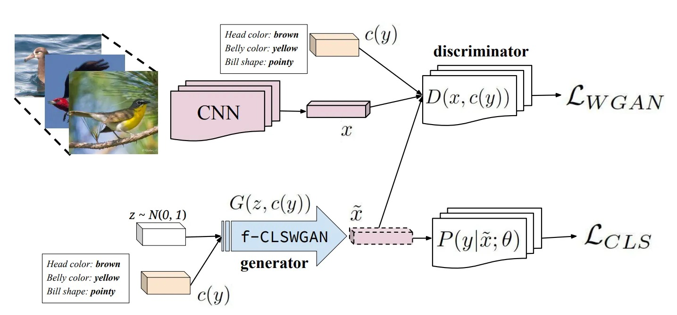



Synthetic method
Implementation Details
1. Pretrain the classifier on the train dataset.
2. Use feature extracted by the classifier to train generator and discriminator.
3. Generate series of fake samples with the generator.
4. Train a final classifier on the test dataset.
Different sample numbers
Different set of lr

Slide 13
研究方法介绍
Sematic Relatedness
Semantic Embedding
Vary model scales
Vary sim-mat generation
Vary model scales
Vary prediction paradigm
Synthetic method
Experiment Settings
Different learning rates
Different fake sample number
Raw data generation

Slide 14
实验设定
Model selection
Big model: with[2048.1024]hidden size
Small model:
with [128] hidden size
Learning rate tuning
Tried LR in ['5e-4', '1e-4', '5e-5', '1e-5', '5e-6', '1e-6']
Sample size
NS in ['1', '400', '1000', '2000']
GAN learning rate
GLR in ['1e-6', '1e-5']
DLR in ['1e-5', '1e-4']

Slide 15
san
叁
PART THREE
研究结果分析
Experiment results and analysis

Slide 16
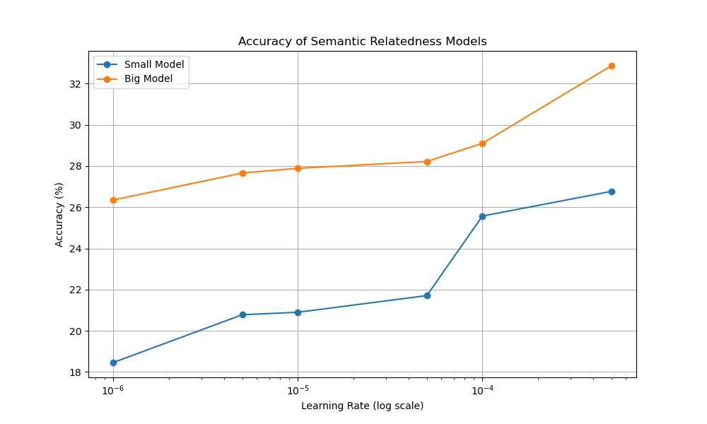



Sematic Relatedness
Binary Feature | Continuous Feature
32.87 | 40.42
Max acc of binary and continuous feature
大模型在此任务中表现更优
5e-4的学习率在学习效果上表现最优
连续特征在准确率上表现最优
Accuracy of big model and small model on different lr settings

Slide 17
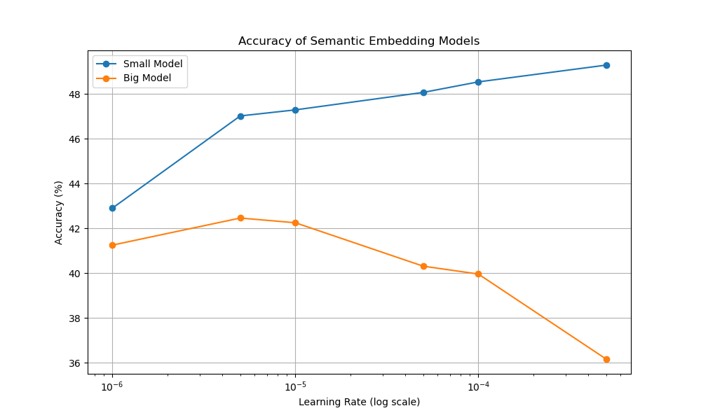
Sematic Embedding
Binary Feature | Continuous Feature
49.29 | 35.62
Max acc of binary and continuous feature
小模型在此任务中表现更优
5e-4的学习率在学习效果上表现最优
大模型合适的学习率则是5e-6
离散特征在准确率上表现最优
Accuracy of big model and small model on different lr settings

Slide 18
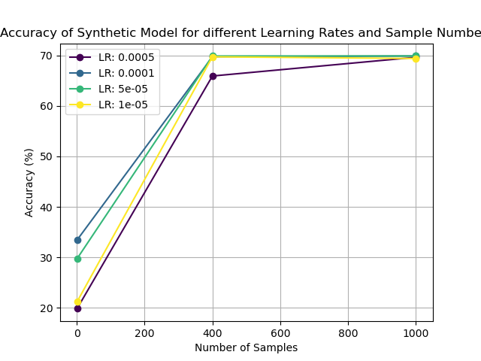
Synthetic Method
LR 1e-6 | LR 1e-5
65.91 | 69.89
Acc change with generator learning rates
增加生成样本量能显著提升性能
样本量添加到400左右，之后对性能提升影响变小
生成器准确率越大越好（1e-5）
判别器准确率影响不大
Accuracy with different learning rates and sample number

Slide 19
si
肆
PART FOUR
研究未来展望
Summarize and future works

Slide 20




研究总结与展望
更丰富的方法
希望在这三种方法之外引入更多方法对比性能
更详尽的参数调节
还有很多变量没有控制
更主流的划分
跟论文的划分方式一致，便于对比实现效果
更卷的报告
多一点，再多一点

Slide 21
gan
xie
qing
ting
感 谢 倾 听
感谢各位老师的倾听和指导
Principles of Data Science
汇报人
陈垍铮

